Slide 1
DNS

Slide 2
Agenda
What is DNS?
Basics of DNS.
How DNS works?
Types of DNS services.

Slide 3
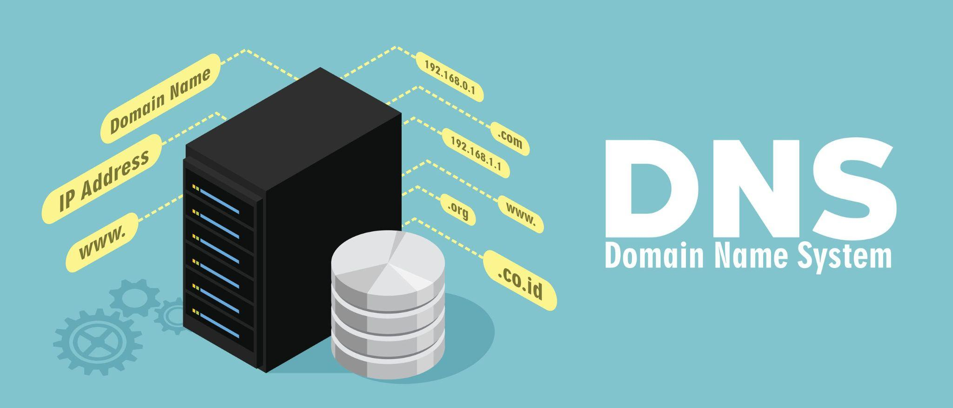
DNS
Domain Name System (DNS).
Converts human-readable domain names
As www.amazon.com.
To machine-readable IP addresses - 192.0.2.44.

Slide 4
DNS Basics
Find and connect.
No need to remember and input a long number when we open a web browser to access a website.
Like thisisexample.com and be directed to the correct location.
Phonebook of the internet.

Slide 5
DNS Basics
Allowing users to choose which server they want to visit when they type a domain name into their browser.
These requests are known as queries.

Slide 6
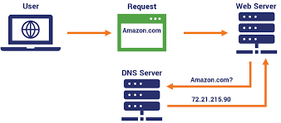
How does DNS works?
Locate the proper Internet device.
User's input which is thisisexample.com.
Locate what we searched on the webpage.

Slide 7

History of DNS
When the internet was extremely small.
Typing a specific IP address into a browse.
An address made up of easy-to-remember words, similar to a domain name.
Assigned in the 1970s and early 1980s.

Slide 8
History of DNS
By one individual in the 1970s and early 1980s.
Master list of every Internet-connected computer.
Handled requests before 6 p.m.
Charged in 1983 with finding a compromise.
Ignored all of them and created DNS.

Slide 9
DNS Services
Authoritative DNS:
To handle their public DNS names.
Converting domain names to IP addresses.
To communicate with one another.
Final authority over a domain.

Slide 10
DNS Services
Recursive DNS:
Recursive DNS server, also known as a recursive resolver.
Resolve the name of a site with its IP address.
Truly have the information.

